Slide 1
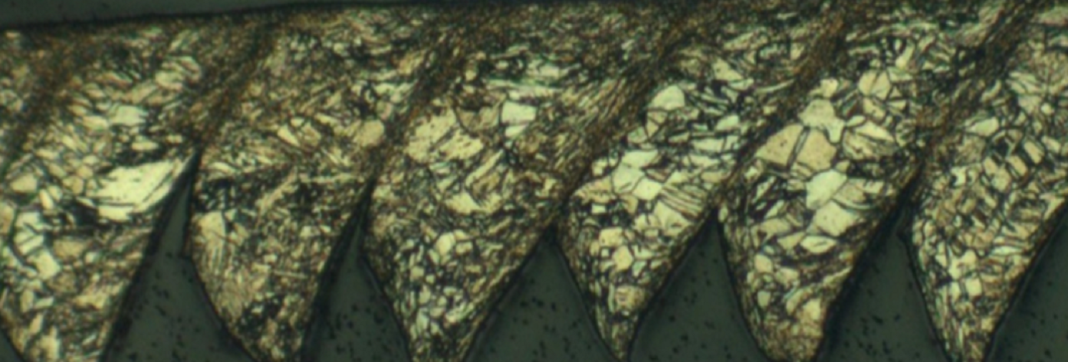
Exploring Process Structure Linkages in Machined Chips
Patxi Fernandez-Zelaia
Ahmet Cecen
December 8, 2014
Material Informatics ME/MSE/CSE 8883

Slide 2
Overview
Machining Introduction
Processing Effects on Microstructure
Problem Statement
Experimental
Microstructure Segmentation
Data Reduction
Results
Conclusions

Slide 3
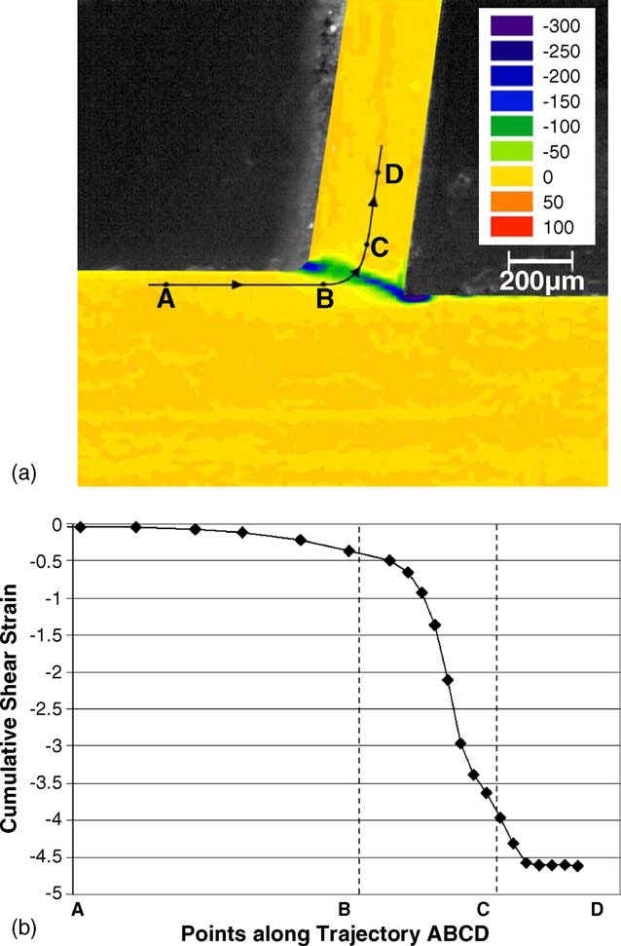

Machining Introduction
Machining processes often follow primary shaping
Large imposed strains under high rate deformation
Up to ~10⁵ s⁻¹, ε=~1-15
Large temperature rise
“Large strain deformation and ultra-fine grained material by machining” Swaminathan et al. 2005

Slide 4
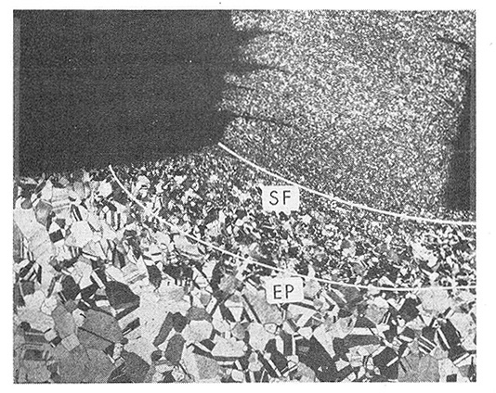
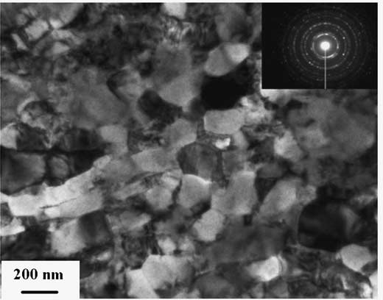
Processing Effects on Microstructure
Thermo-mechanical loading induces microstructural evolution
Grain refinement
Dislocation density evolution
Twinning
…
“On the Metal Physical Considerations in the Machining of Metals” Ramalingam & Black 1972
“Large strain deformation and ultra-fine grained material by machining” Swaminathan et al. 2005

Slide 5
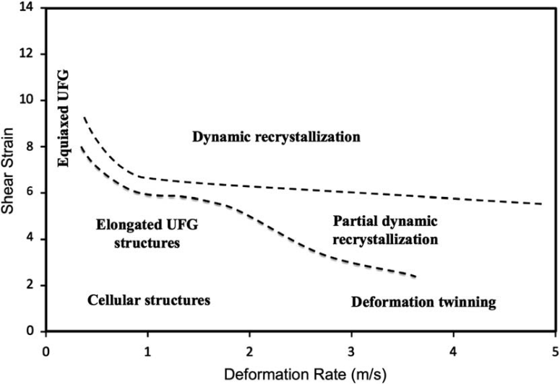
Problem Statement
Manufacturing community has begun to study process-structure relationships in machining
Our goal is to explore process-structure linkages while quantifying structure gradients present in machined chips and
“A study of the interactive effects of strain, strain rate and temperature in severe plastic deformation of copper” Brown et al. 2009
250μm

Slide 6
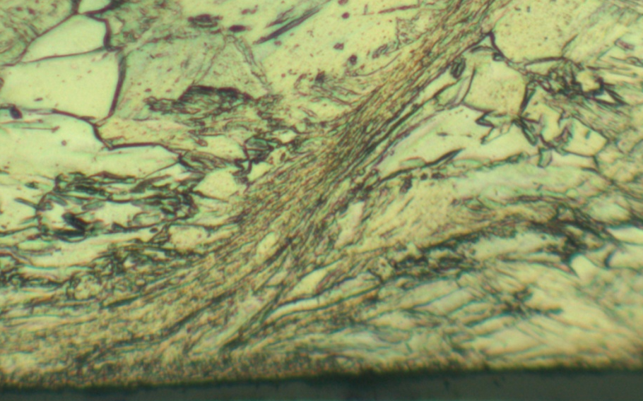
Problem Statement
Focus in this study is to first attempt to quantify gradients in the vertical direction (x-dir)
Analyze 7 unique processing conditions
Explore linkages in PCA space
250μm
x

Slide 7
Experimental
Orthogonal cutting experiments performed varying:
Feed (f)
Cutting velocity (V)
Process conditions (f,V) affect thermomechanical processing and hence structure
CP-Ti (Gr 5) chips collected, etched and imaged using optical microscopy
5 images taken along the length of each chip
Assuming all segments in a chip are representative of the imposed processing conditions
chip
f
V
workpiece

Slide 8
Microstructure Segmentation
Image alignment
RGB→ Gray scale
Filtering
Canny edge detection
Chord length distribution generation

Slide 9
Data Reduction
Chord length distributions at each row were

Slide 10
Machine Learning
Can we predict PC1 for any given speed given the three remaining speeds?

Slide 11
Results

Slide 12
Conclusions

Slide 13
Questions?

Slide 14
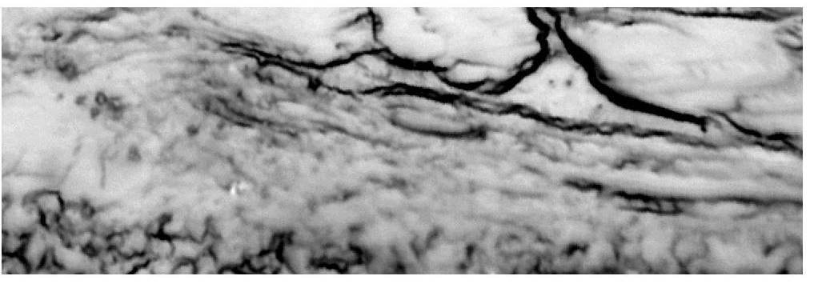
Chord Length Distribution
Two distributions were considered
(1) lacks sufficient sensitivity to quantify structure
(2) weights larger chords and as such is more useful
P(X=x) probability that a chord is length x
P(X=x) probability that a pixel is found in a chord of length x

Slide 15
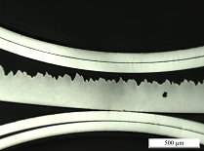
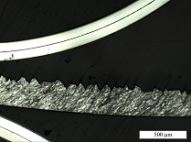
Etching Gradients
All samples illustrated varying degrees of etch gradients
Sample 32 displayed greatest degree of etch gradient
Effects of etch gradient displayed in PCA space
Etch Gradient
Sample 32

Slide 16
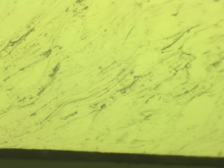
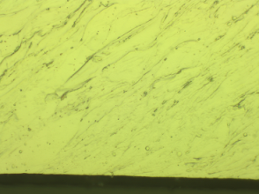
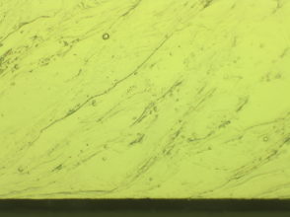
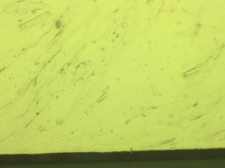
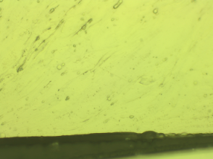
Etching Gradients
Acquisition Order

